Slide 1
Super bowl xlix
“I’m just here so I don’t get fined” #beastmode

Slide 2
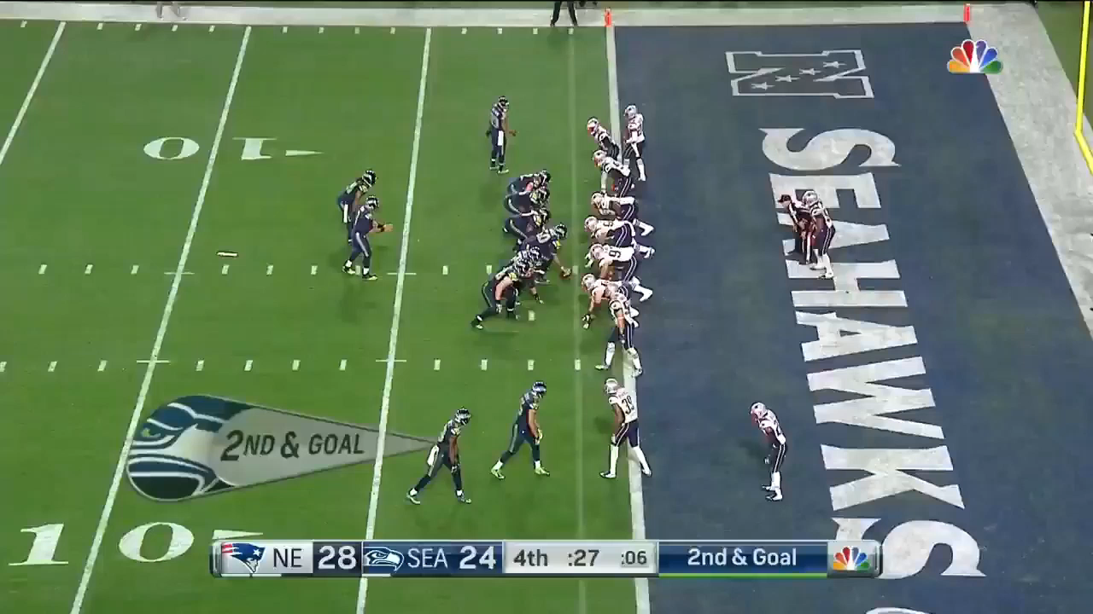
Purpose
The video depicts what is widely touted as one of the worst calls in NFL history.
The goal of our project is to determine if that is true.
Notes:
Half of you already know what it is that I am about to show you and are already cringing; the other half of you started dozing off the moment you saw any reference to sports. But, if you’re interested in analytics you should care about this play. The Seahawks lost the Super Bowl because of it.
This was the final play of consequence in Super Bowl 49. The Seattle Seahawks have the ball on the New England Patriots 1-yard line and need a touchdown to win. What happens next is awful and gut wrenching.
{plays video}
With enough time to run multiple plays and a timeout remaining, the Seahawks chose to pass the ball on second down, were intercepted and ultimately lost the game. And that is all due to this man’s poor decision making in the clutch. Or, at least that is what people think.
The goal of our project is to determine whether or not this was a terrible play call.

Slide 3
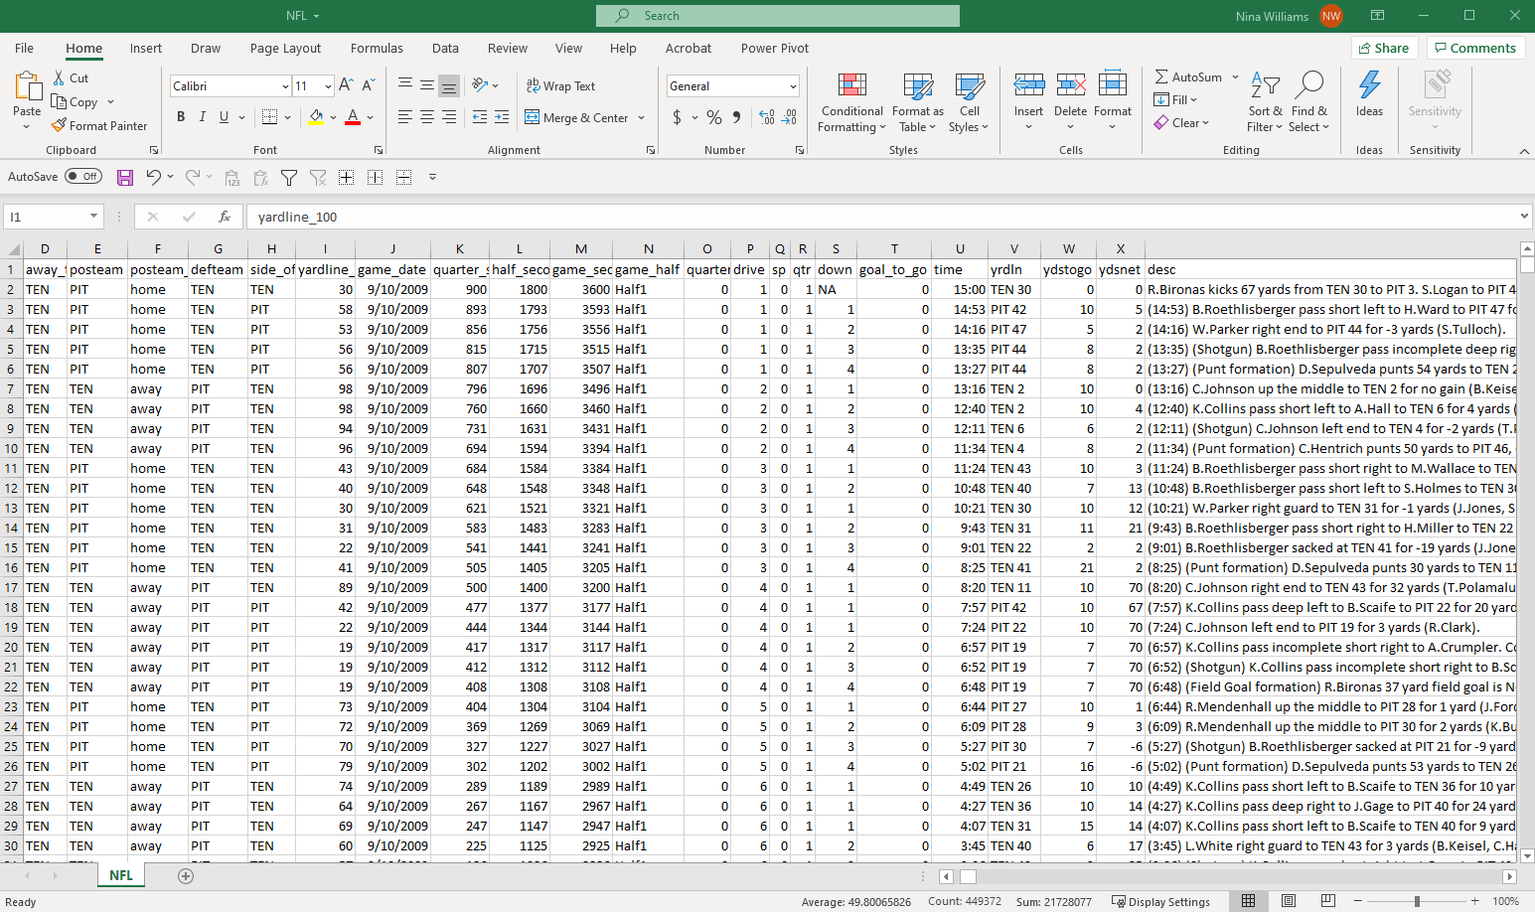
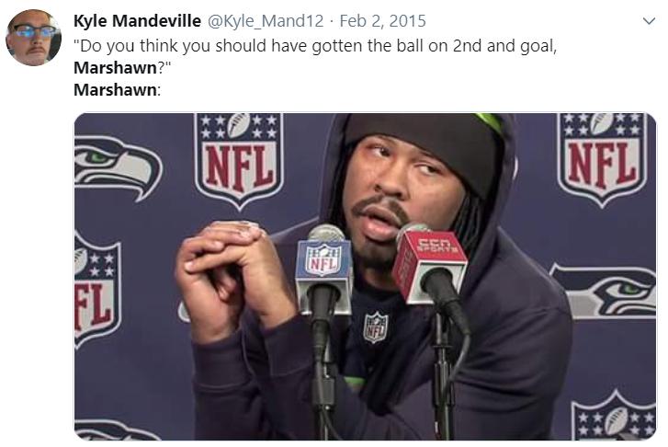
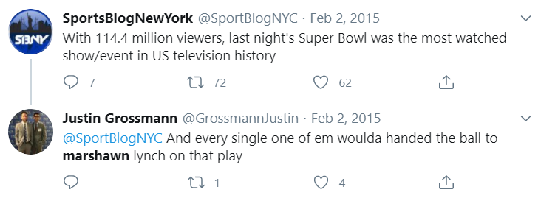
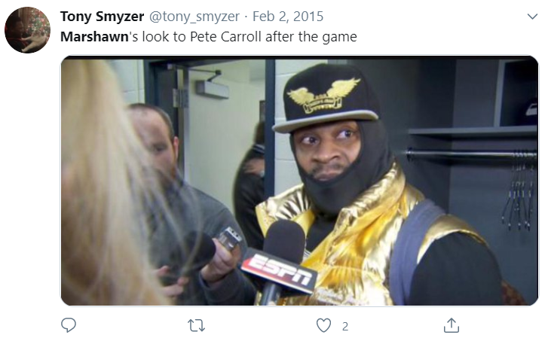
Our data
449,000 rows
255 columns
Every play from 2009 – 2018
5,000 tweets with the keywords “Marshawn Lynch” from the day after the Super Bowl.

Slide 4
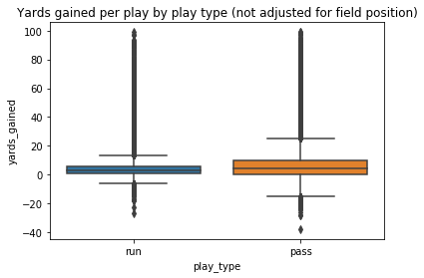
Run or pass?
Data analyzed
All data from all teams
Not adjusted for field position
Observations
Passing is volatile with a high ceiling and low floor.
Running has a reduced chance of a negative play while maintaining a median value greater than one.

Slide 5
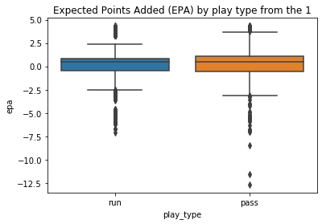
what about on the Goal line?
Data analyzed
All data from all teams
Adjusted for field position
Observations
Expected points per play difference is minimal.
Too much of the distribution in passing plays is negative.

Slide 6
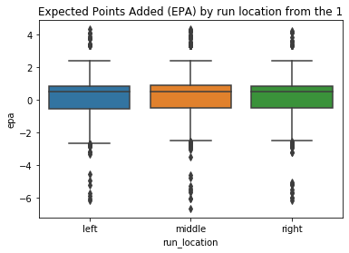
Does direction matter?
Data analyzed
All data from all teams
Adjusted for field position
Observations
No statistical difference between data on the whole.
There may be still a local optimum for each team based on personnel and scheme.

Slide 7
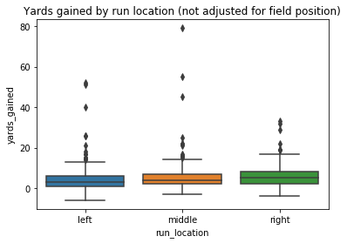
Does direction matter for sea?
Data analyzed
2015 Seahawks data
Not adjusted for field position
Observations
The median outcome for the Seahawks is better when they run the ball to the right.
This is ironic as they spent a lot of draft capital on the left side of their offensive line.

Slide 8
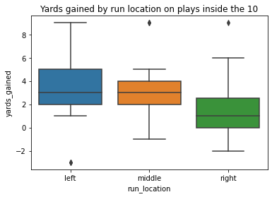
What about close to the goal line?
Data analyzed
2015 Seahawks data
Adjusted for field position
Observations
The team is better off when they run the ball to the left when they are inside the 10.

Slide 9
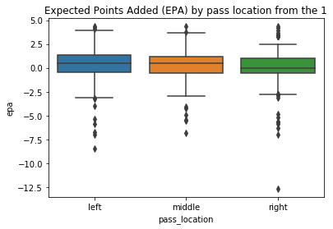
Did they even pass to the right place?
Data analyzed
2015 Seahawks data
Adjusted for field position
Observations
The pass was thrown to the least optimal location based on their previous attempts that year.

Slide 10
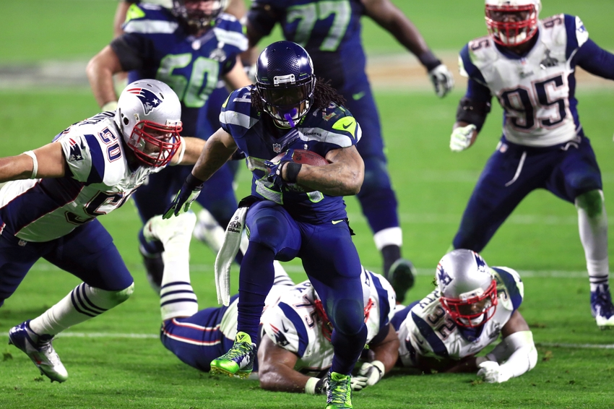
Optimal 2nd down decision?
Marshawn left
Marshawn right
Marshawn center
…even a QB sneak would have been a better call given the scenario

Slide 11
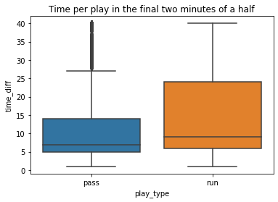
They didn’t get it… now what?
Data analyzed
All data from all teams
Adjusted for time left on clock
Observations
It takes slightly longer to run the ball than to pass it in the final two minutes of a half.
With one timeout, an average run play that didn’t work would have left 16 seconds.
That is enough time to pass on third AND, if they don’t score, they still have time to run Marshawn again…

Slide 12
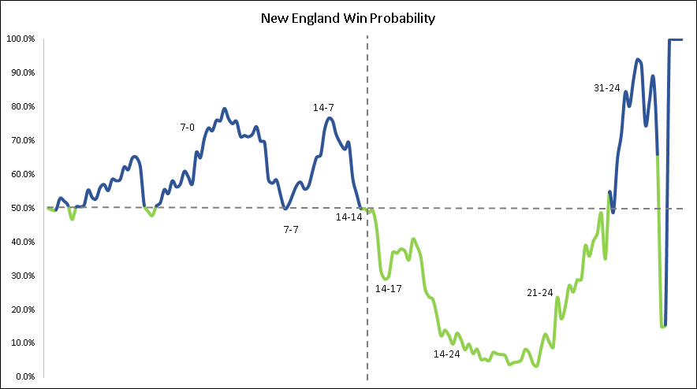
Outcome of passing?
Data analyzed
Super Bowl XLIX game data
Observations
They blew it…
The Seahawks were nursing an 85% chance of winning with the ball on the 1-yard line and should have taken multiple, low risk attempts at scoring.
Notes:
With 66 seconds left in the game the clock was stopped and the Seahawks had the ball on the five-yard line with one timeout remaining. They ran the ball to the left and got down to the one yard line. The situation was that they were 2nd and goal from the one with 60 seconds left and the 40 second clock (play clock) ticking they ran the clock all the way down to 26 seconds when they snapped it. At this point there were two options: 1. Run, or 2. Pass. The play call was pass and it should have been run (preferably Quarter Back sneak). If they had run it and not gotten the ball in the end zone they then could have called their final timeout leaving them with 15 seconds and 2 downs (at most) to score with 15 seconds and 0 timeouts, there are two options: 1. Pass the ball in or 2. Run the ball likely against their pass defense.
The optimal decision is NOW to pass the ball being that an incomplete pass stops the clock it should have been a fade or other low percentage interception play instead of a slant. However then, if you still have not scored and it is 4th and 1, you give it to the best power back in football and let him work...but Pete Carroll is a clown in 2015 sports illustrated wrote an article referencing how NFL teams were treating analytics:
https://www.espn.com/espn/feature/story/_/id/12331388/the-great-analytics-rankings
The Seahawks were referenced as being "one foot in" despite the team’s owner being no other than Paul Allen, the co-founder of Microsoft so, let us see how the fans responded on twitter to this boneheaded call.

Slide 13
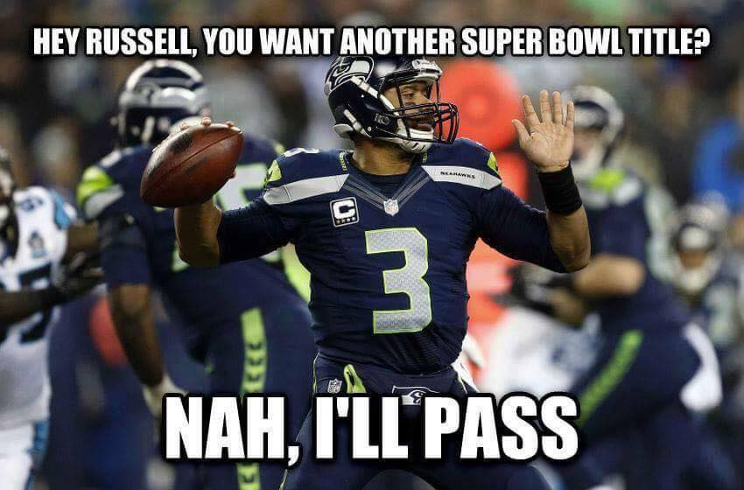
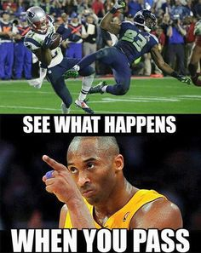
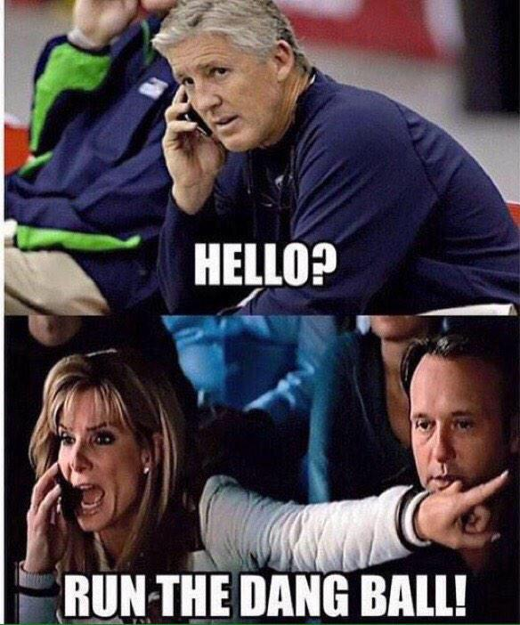
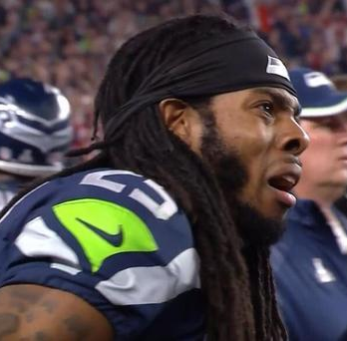
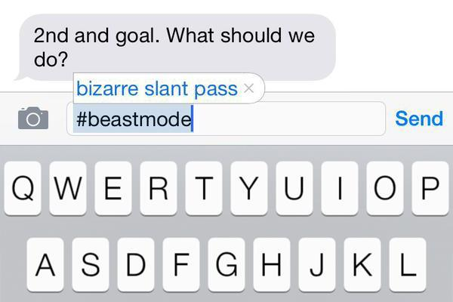
So, what did twitter do?
Data analyzed
5,000 tweets
Day after Super Bowl
Keyword “Marshawn Lynch”
Observations
Meme lords went wild
JPG, PNG, links, etc.
Notes:
With 66 seconds left in the game the clock was stopped and the Seahawks had the ball on the five-yard line with one timeout remaining. They ran the ball to the left and got down to the one yard line. The situation was that they were 2nd and goal from the one with 60 seconds left and the 40 second clock (play clock) ticking they ran the clock all the way down to 26 seconds when they snapped it. At this point there were two options: 1. Run, or 2. Pass. The play call was pass and it should have been run (preferably Quarter Back sneak). If they had run it and not gotten the ball in the end zone they then could have called their final timeout leaving them with 15 seconds and 2 downs (at most) to score with 15 seconds and 0 timeouts, there are two options: 1. Pass the ball in or 2. Run the ball likely against their pass defense.
The optimal decision is NOW to pass the ball being that an incomplete pass stops the clock it should have been a fade or other low percentage interception play instead of a slant. However then, if you still have not scored and it is 4th and 1, you give it to the best power back in football and let him work...but Pete Carroll is a clown in 2015 sports illustrated wrote an article referencing how NFL teams were treating analytics:
https://www.espn.com/espn/feature/story/_/id/12331388/the-great-analytics-rankings
The Seahawks were referenced as being "one foot in" despite the team’s owner being no other than Paul Allen, the co-founder of Microsoft so, let us see how the fans responded on twitter to this boneheaded call.

Slide 14

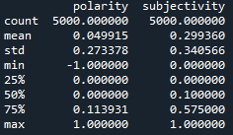
So, what did twitter do?
Data analyzed
5,000 tweets
Day after Super Bowl
Keyword “Marshawn Lynch”
Observations
Results were surprisingly slightly positive
Twitter is based on facts, not feelings?
Notes:
With 66 seconds left in the game the clock was stopped and the Seahawks had the ball on the five-yard line with one timeout remaining. They ran the ball to the left and got down to the one yard line. The situation was that they were 2nd and goal from the one with 60 seconds left and the 40 second clock (play clock) ticking they ran the clock all the way down to 26 seconds when they snapped it. At this point there were two options: 1. Run, or 2. Pass. The play call was pass and it should have been run (preferably Quarter Back sneak). If they had run it and not gotten the ball in the end zone they then could have called their final timeout leaving them with 15 seconds and 2 downs (at most) to score with 15 seconds and 0 timeouts, there are two options: 1. Pass the ball in or 2. Run the ball likely against their pass defense.
The optimal decision is NOW to pass the ball being that an incomplete pass stops the clock it should have been a fade or other low percentage interception play instead of a slant. However then, if you still have not scored and it is 4th and 1, you give it to the best power back in football and let him work...but Pete Carroll is a clown in 2015 sports illustrated wrote an article referencing how NFL teams were treating analytics:
https://www.espn.com/espn/feature/story/_/id/12331388/the-great-analytics-rankings
The Seahawks were referenced as being "one foot in" despite the team’s owner being no other than Paul Allen, the co-founder of Microsoft so, let us see how the fans responded on twitter to this boneheaded call.

Slide 15
Super bowl xlix
discussion

